Slide 1
Uber Supply-Demand Gap Case Study
By
Pravin Pawar

Slide 2
Business Objective
Objective
Identify Root Cause of Uber Demand Supply Gap on Airport Route
Identify Root Cause of Driver Cancellation
Identify Root Cause of Car Unavailability
Identify Most Problematic Route
Airport to City
City to Airport
Recommendation to reduce Demand Supply Gap

Slide 3
Data Observation & Preparation
Total 6745 observation found.
Final status of trip
Trip Completed
No Cars Available
Cancelled
Pickup Points
City
Airport
Car Booking Request Time & Drop Off Time not in proper format.
Covert column in Date Time format
Derive new columns like Hour and Time Of Day for booking request made.
Missing data for Driver Id & Drop Off Time
Drop time is available only when trip is completed, according to this data is valid.
Driver id available when trip is completed or driver rejected/cancelled booking request, in this scenario also data is valid.

Slide 4
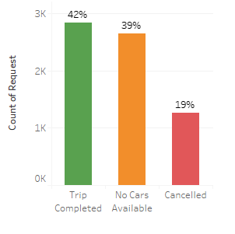
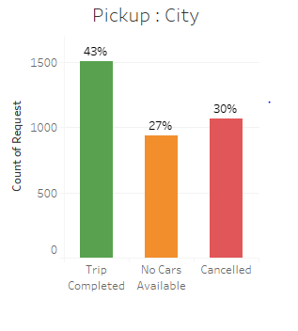
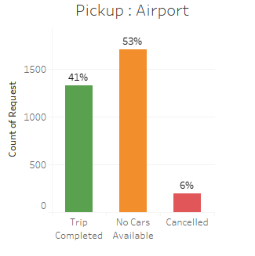
Analysis
Observation
On Airport route, overall only 42% of total request get fulfilled.
Approximately same pattern observed in City to Airport(43%) & Airport to City (41%) trip.
In City pickup there are equal number of booking cancellation & car unavailability issue occurs.
In case of Airport pickup, not much cancellation happening, major problem with Cars Unavailability at Airport.

Slide 5
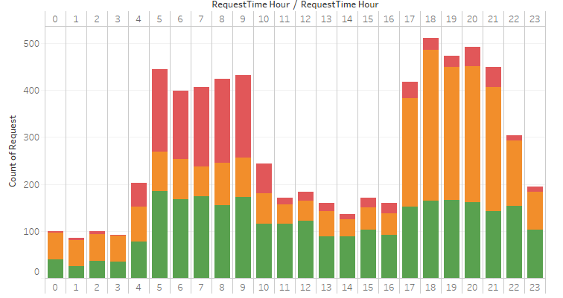

Analysis
Observation
Analyse cab demand & supply trend by hour of the day
Graph shows Bimodal Distribution of request.
First peak at 5 am to 9 am
High rate of cancellation in this time slot
Few of the cases of car unavailability
Where as second peak at 5 pm to 10 pm
Very few cancellations happing
More than 50% of request facing car
unavailability issue in this slot.

Slide 6
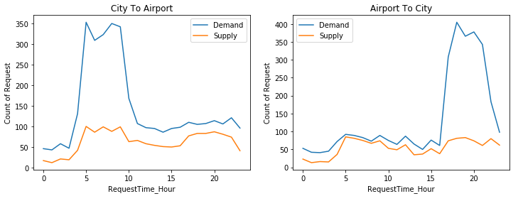
Analysis
Observation : City vs Airport Pickup
Demand of cars are high for City to Airport trip from 5 am to 10 am, approximately 325 request coming per hour but the supply was very less around 100 request get fulfilled, so approximately 70% of gap in demand and supply.
Whereas in Airport to City trip demand was high from 4 pm to 10 pm, here approximately 350 request per hour but around 75 request get fulfilled, so approximately 80% of gap in demand and supply.

Slide 7
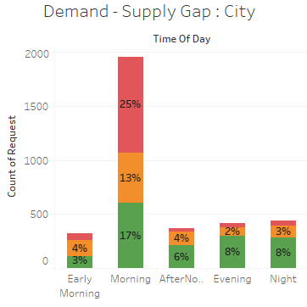
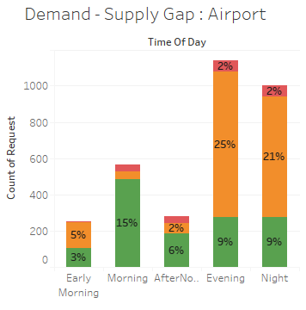
Analysis
Observation : City vs Airport Pickup
City Pickup: Overall 25% of cancellation is happening in morning hours, apart from that 13% car unavailable for airport drop
Airport Pickup: Overall 50% of request of the day not getting fulfilled in Evening & Night hours, major reason is car unavailability (46 %)
Derived Field
Early Morning: 12 AM To 5 AM
Morning: 5 AM To 12 PM
Afternoon: 12 PM To 4 PM
Evening: 4 PM To 8 PM
Night: 8 PM To 12 AM

Slide 8
Conclusion
Problem Area: City vs Airport Pickup
Overall there is huge demand and supply gap in car booking.
Reason behind heavy Cancellation in Morning hours for City pickup
City to airport trip normally take 50-55 minutes (average).
In Day time (Morning & Afternoon hours) there is very less demand from Airport to City.
So if driver accepted City to Airport trip, he have to wait for longer time at Airport for next trip.
Driver might get more trips within City in morning (peak) hours and can earn more as compare to Airport drop.
Reason behind Car Unavailability in Evening & Night hours for Airport pickup
In evening & night hours many international and domestic flights are arriving, because of this sudden spike in demand of cars.
In evening hours very less cars moving towards Airport because of low demand for City to Airport trip
Hence Car Unavailability issue occurs at Airport in Evening & Night hours.
So problem is most of the drivers not willing to go Airport because of less demand in day time and can’t wait ideal for long time.
Demand & Supply Gap at Airport pickup in evening hours is 50% where as its 38% in morning hours for City pickup

Slide 9
Recommendation
Recommendation
Encourage driver to accept airport trips in morning hours by providing incentive per airport trip.
Once driver accept City to Airport trip, try to reduce driver wait time at airport by providing near by pickup on priority basis.
In night hours driver should to be at Airport or at near by location to accept Airport To City trip.
Provide some incentive and additional benefit to such driver so they accept the Night airport trip..

